Slide 1
Kaggle Competition: San Francisco Crime Classification
Amit Talapatra, Wendy Zhang, Wei Zheng

Slide 2
Data
Train and Test contain these variables:
Dates - timestamp of the crime incident
Category - category of the crime incident (only in train.csv). This is the target variable.
Descript - detailed description of the crime incident (only in train.csv)
DayOfWeek - the day of the week
PdDistrict - name of the Police Department District
Resolution - how the crime incident was resolved (only in train.csv)
Address - the approximate street address of the crime incident
X - Longitude
Y - Latitude

Slide 3
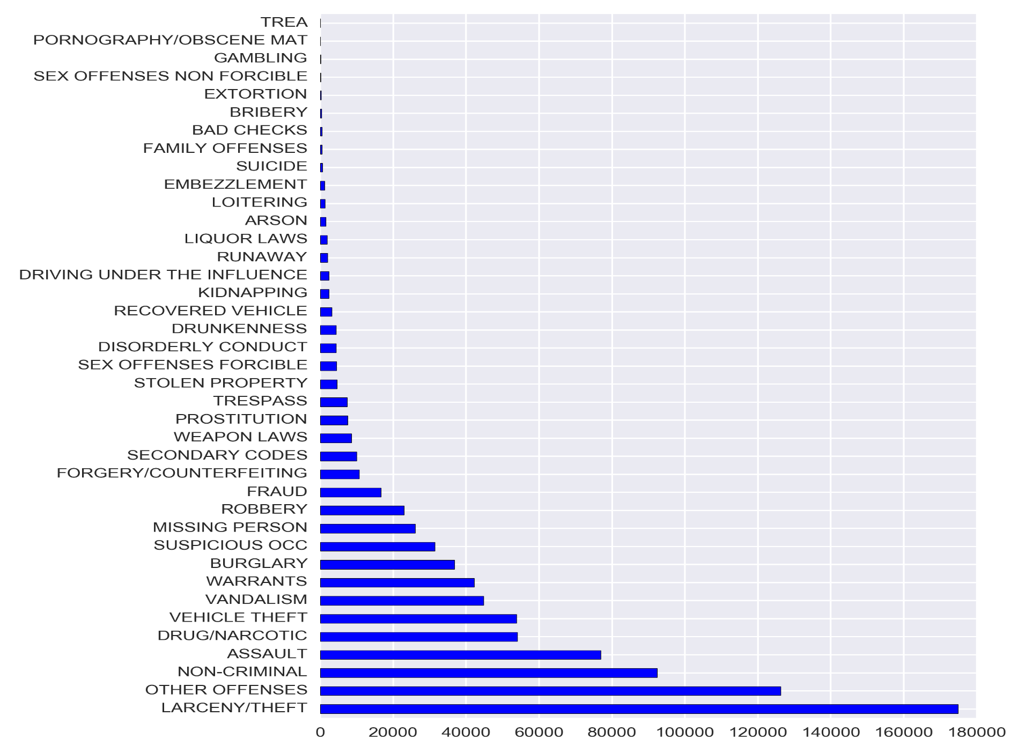
Crime Categories

Slide 4
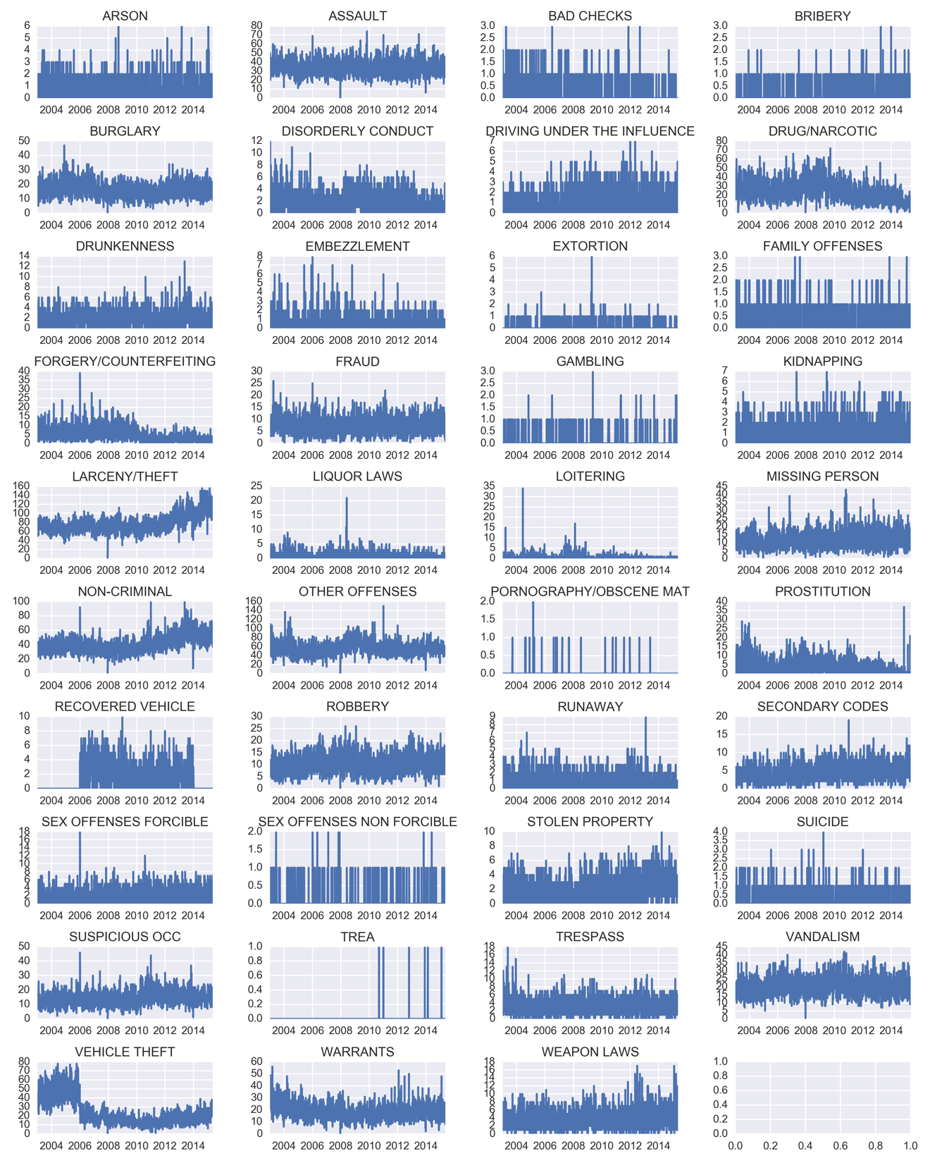
Crime Count by Date

Slide 5
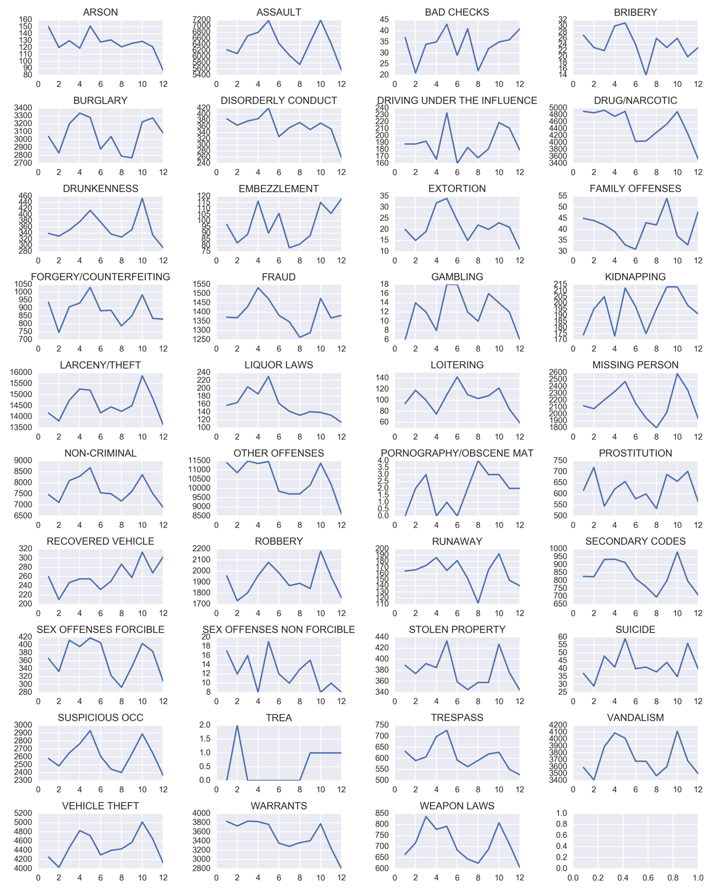
Crime Count by Month

Slide 6
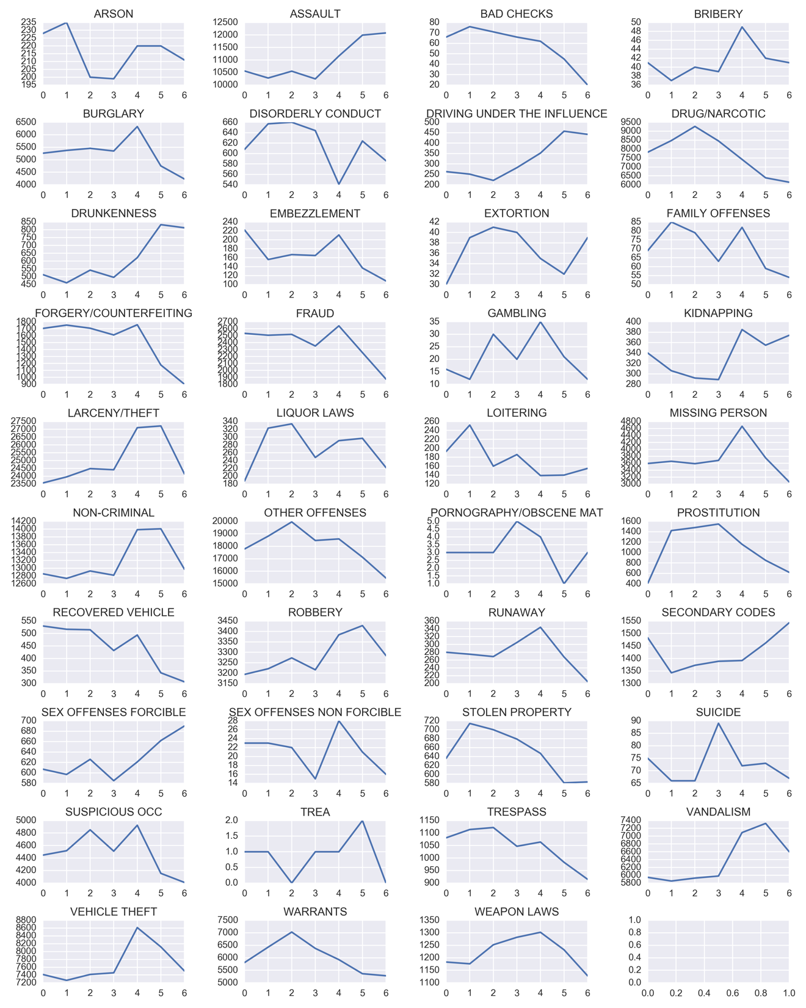
Crime Count by
Weekday

Slide 7
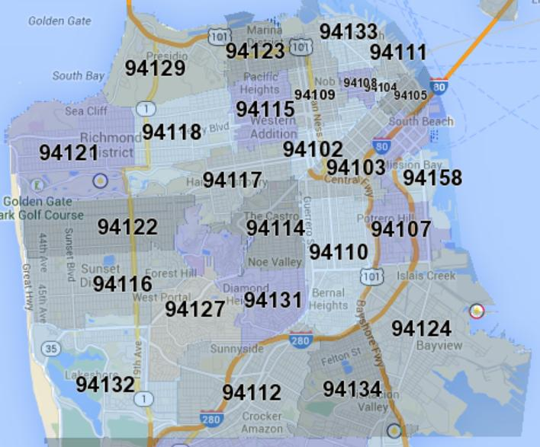
Feature Engineering
Using Dates to create:
Hour
Month
Year
Using X (longitude) and Y (latitude), Address, or PD District to identify zip codes:
Possible methods: PROC GEOCODE, Texas A&M Geocoding Service, Ideas?
Adding locational data to the dataset:
From SF OpenData
Additional crime data, traffic data, etc. could be added to our dataset by zip code/PD district.

Slide 8
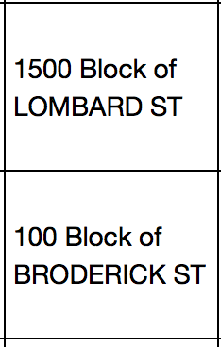
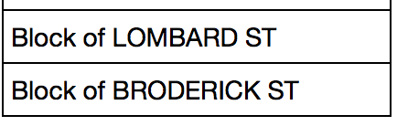
Feature Engineering
Lowering granularity by removing house number from Address

Slide 9
Initial Model Runs
Regression
Decision Tree
Neural Network

Slide 10
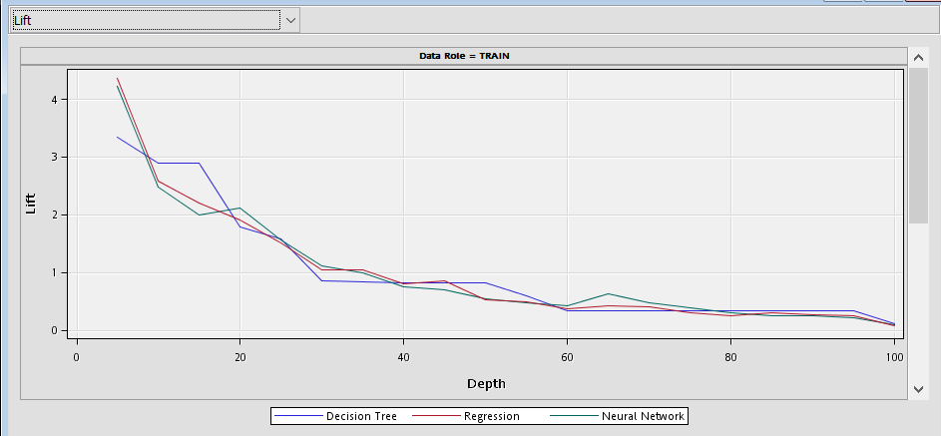
Lift Curve

Slide 11
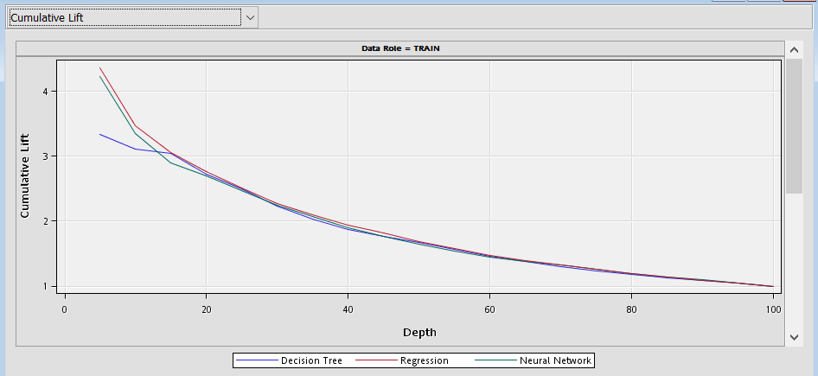
Cumulative Lift Curve

Slide 12
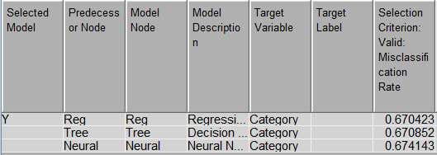
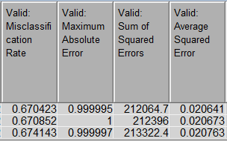
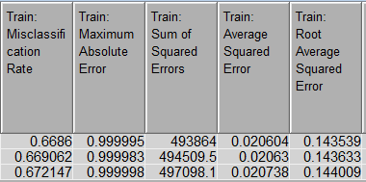
Fit Statistics – Comparison of all models
Lowest Validation Misclassification Rate

Slide 13
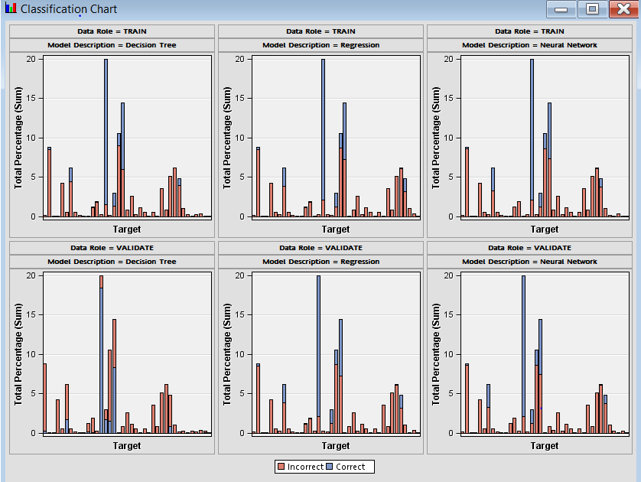
Classification Chart

